Slide 1
Application of Generative Adversarial Network for Data Augmentation in Diabetic Retinopathy
ICCCNT 2024
Paper ID: 507
Anuj Kumar
Rimjhim Padam Singh
Department of Computer Science and Engineering
Amrita School of Computing, Bengaluru
Amrita Vishwa Vidyapeetham, India

Slide 2
Table of content:
Abstract
Introduction
Dataset
Methodology
Result
Conclusion
References

Slide 3
Abstract
Application of GAN on generation of eye fundus images for the disease diabetic retinopathy (DR) has not been explored in depth.
This paper shows a novel approach to generate low resolution eye fundus images for DR using GAN and validate it though a CNN classifier using samplers and schedulers module.
The proposed approach beats the current benchmark in terms of generated image quality as well as classification accuracy.
The low-quality generated images of 224*224 pixels manages to retain the key aspects of DR which aids in identifying the DR grade during classification predominantly from generated images only.

Slide 4
Introduction
The efficient technique DCGAN implemented in this paper, expands the idea of GAN by concatenating several layers of convolution operations which upscale the images for low resolution pictures.
For quantitative validation and authentication of GAN generated images, first a classification model is trained to grade DR images using real data and then gradually real data are removed and replaced with fake images and classification models are again trained.
The two models are compared to show how fake images affect the classification accuracy

Slide 5
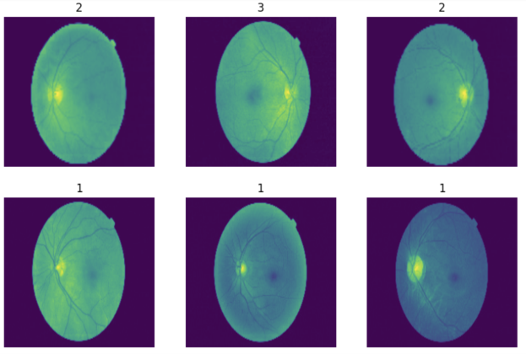
Dataset
Distribution of images in DR category
MESSIDOR dataset
1200 total images
Original image size 1440*960
Preprocessing:
Resized to 224*224
Pixels are normalized between (0,1).
Grade | Severity | No. of images
R0 | Normal | 540
R1 | Mild | 153
R2 | Moderate | 247
R3 | Severe | 260
DR Grading
Class labels | Descriptions | No. of images
DR | R0/R1/R2/R3 | 546/153/247/254
Normal/Abnormal | R0/R1, R2, R3 | 546/654
Non -referable / referable | R0, R1/R2, R3 | 699/501
Sample images from dataset

Slide 6
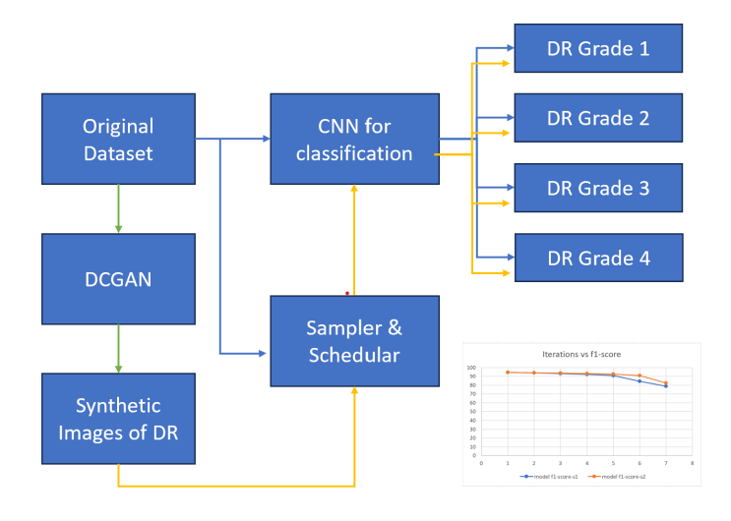
Methodology
Solution architecture:

Slide 7
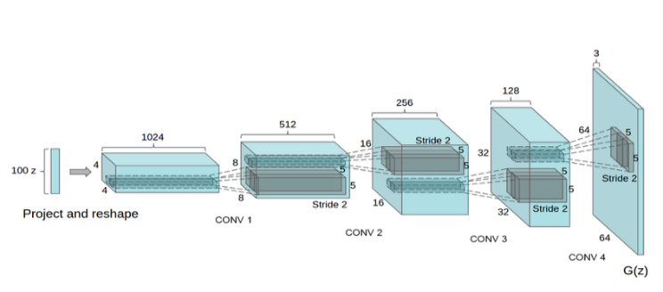
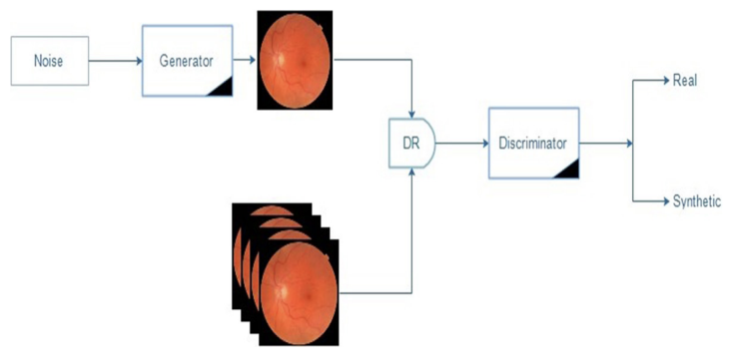
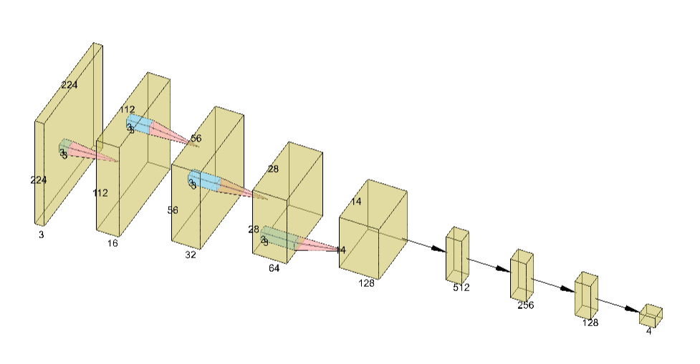
Methodology
GAN architecture:
Generator
Parameter Name | Value
Discriminator learning rate | 0.00025
Generator learning rate | 0.00015
Epoch | 200
Optimizer | Adam
Loss function | Categorical cross-entropy
Latent dimensions | 128
Batch size | 32
Number of layers in Generator | 14
Number of layers in Discriminator | 12
No. of parameters in Generator | 2M
No. of parameters in Discriminator | 0.5M
Discriminator

Slide 8
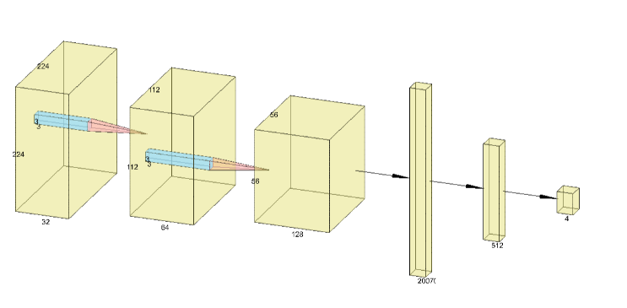
Methodology
Classification Module (CNN):
Parameter name | Value
Epoch | 50
Batch size | 32
Learning rate | 0.001
Optimizer | Adam
Loss | Categorical cross entropy
Number of hidden layers | 11
Number of parameters | 26M

Slide 9
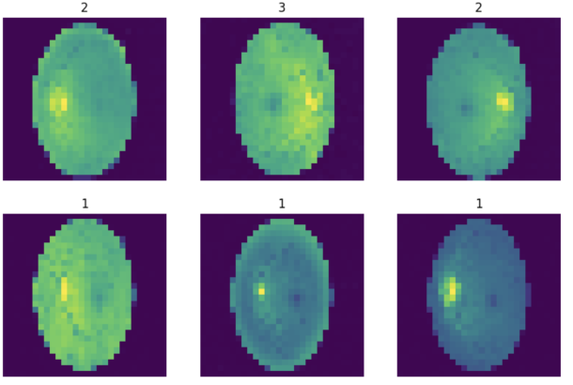
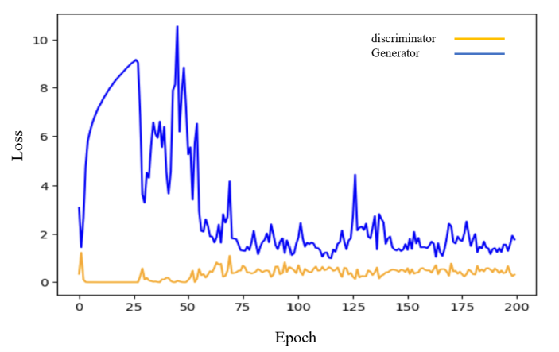
Result:
GAN training loss (generator and discriminator):
Generated Images
FID score of generated images after each epoch
Epochs | FID
50 | 9.126
100 | 5.854
150 | 3.546
200 | 1.854

Slide 10
Result
Comparison with literature
Model | Accuracy | F1-Score
VSG-GAN [19] | 67% | 79%
DR-LL GAN [20] | 94.2% | Not reported
Deepfakes [21] | 98.19% | 60.1%
Our Model | 94.3% | 92.25%
Classification model performance:
gen. image % | Sampling type | # fake images | # real images | F1 Score (%) | Acc. (%) | Pre. (%) | recall (%)
0 | uniform | 0 | 1200 | 96.85 | 96.28 | 98.4 | 99.45
10 | uniform | 120 | 1080 | 95.08 | 95.86 | 97.3 | 99.33
20 | uniform | 240 | 960 | 95.58 | 94.91 | 98.9 | 98.11
50 | uniform | 600 | 600 | 92.33 | 93.44 | 98.4 | 96.33
70 | uniform | 840 | 360 | 89.06 | 92..99 | 95.2 | 97.22
90 | uniform | 1080 | 120 | 81.10 | 89.21 | 94.2 | 92.32
100 | uniform | 1200 | 0 | 77.40 | 84.46 | 90.2 | 93.45
10 | pro. | 120 | 1080 | 98.51 | 97.34 | 99.2 | 99.8
20 | pro. | 240 | 960 | 97.03 | 96.44 | 98.6 | 99.4
50 | pro. | 600 | 600 | 93.54 | 95.6 | 97.5 | 98.1
70 | pro. | 840 | 360 | 92.25 | 94.3 | 96.5 | 98.2
90 | pro. | 1080 | 120 | 90.28 | 91.2 | 95.8 | 97.5
100 | pro. | 1200 | 0 | 81.64 | 86.5 | 90.2 | 96.8

Slide 11
Conclusion:
Increasing image resolution may further improve classification performance but it may require more compute and inference may become slower.

Slide 12
References:
Abbood, S. H., Abdull Hamed, H. N., Mohd Rahim, M. S., Alaidi, A. H. M., & Salim ALRikabi, H. T. (2022). DR-LL Gan: Diabetic Retinopathy Lesions Synthesis using Generative Adversarial Network. International Journal of Online & Biomedical Engineering, 18(3).
Reddy, G. T., Bhattacharya, S., Ramakrishnan, S. S., Chowdhary, C. L., Hakak, S., Kaluri, R., & Reddy, M. P. K. (2020, February). An ensemble based machine learning model for diabetic retinopathy classification. In 2020 international conference on emerging trends in information technology and engineering (ic-ETITE) (pp. 1-6). IEEE.
Chetoui, M., Akhloufi, M. A., & Kardouchi, M. (2018, May). Diabetic retinopathy detection using machine learning and texture features. In 2018 IEEE Canadian conference on electrical & computer engineering (CCECE) (pp. 1-4). IEEE.
Goodfellow, I., Pouget-Abadie, J., Mirza, M., Xu, B., Warde-Farley, D., Ozair, S., ... & Bengio, Y. (2020). Generative adversarial networks. Communications of the ACM, 63(11), 139-144.
Wang, S., Wang, X., Hu, Y., Shen, Y., Yang, Z., Gan, M., & Lei, B. (2020). Diabetic retinopathy diagnosis using multichannel generative adversarial network with semisupervision. IEEE Transactions on Automation Science and Engineering, 18(2), 574-585.
Bhatia, K., Arora, S., & Tomar, R. (2016, October). Diagnosis of diabetic retinopathy using machine learning classification algorithm. In 2016 2nd international conference on next generation computing technologies (NGCT) (pp. 347-351). IEEE.
Priya, R., & Aruna, P. (2013). Diagnosis of diabetic retinopathy using machine learning techniques. ICTACT Journal on soft computing, 3(4), 563-575.
Roychowdhury, S., Koozekanani, D. D., & Parhi, K. K. (2013). DREAM: diabetic retinopathy analysis using machine learning. IEEE journal of biomedical and health informatics, 18(5), 1717-1728.
Zhou, Y., Wang, B., He, X., Cui, S., & Shao, L. (2020). DR-GAN: conditional generative adversarial network for fine-grained lesion synthesis on diabetic retinopathy images. IEEE Journal of Biomedical and Health Informatics, 26(1), 56-66.
Niu, Y., Gu, L., Zhao, Y., & Lu, F. (2021). Explainable diabetic retinopathy detection and retinal image generation. IEEE journal of biomedical and health informatics, 26(1), 44-55.
Xiao, Q., Zou, J., Yang, M., Gaudio, A., Kitani, K., Smailagic, A., ... & Xu, M. (2019, August). Improving lesion segmentation for diabetic retinopathy using adversarial learning. In International Conference on Image Analysis and Recognition (pp. 333-344). Cham: Springer International Publishing.
J.-Y. Zhu, T. Park, P. Isola, and A. A. Efros, “Unpaired image-to-image translation using cycle-consistent adversarial networks,” in Proc. IEEE Int. Conf. Comput. Vis., 2017, pp. 2223–2232.
A. Brock, J. Donahue, and K. Simonyan, “Large scale GAN training for high fidelity natural image synthesis,” in Proc. Int. Conf. Learn. Representations, 2019.
Chong, M. J., & Forsyth, D. (2020). Effectively unbiased fid and inception score and where to find them. In Proceedings of the IEEE/CVF conference on computer vision and pattern recognition (pp. 6070-6079).
Shmelkov, K., Schmid, C., & Alahari, K. (2018). How good is my GAN?. In Proceedings of the European conference on computer vision (ECCV) (pp. 213-229).
E. Decencière, X. Zhang, G. Cazuguel, B. Lay, B. Cochener, C. Trone, P. Gain, R. Ordonez, P. Massin, A. Erginay, B. Charton, and J-C. Klein. "Feedback on a publicly distributed database: the Messidor database," Image Analysis & Stereology, v. 33, n. 3, p. 231-234, 2014.
Singh RP, Sharma P. “A light-weight change detection method using ycbcr-based texture consensus model”. International Journal of Pattern Recognition and Artificial Intelligence. 2020 Aug 6;34(09):2050023.
Vasista, T. Sai, Rimjhim Padam Singh, and Priyanka Kumar. "Advancing Healthcare: Unleashing the Potential of Cryptography, Blockchain, and Machine Learning." In 2023 14th International Conference on Computing Communication and Networking Technologies (ICCCNT), pp. 1-6. IEEE, 2023.
Liu, J., Xu, S., He, P., Wu, S., Luo, X., Deng, Y., & Huang, H. (2024). VSG-GAN: A High Fidelity Image Synthesis Method with Semantic Manipulation in Retinal Fundus Image. Biophysical Journal.
Abbood, S. H., Abdull Hamed, H. N., Mohd Rahim, M. S., Alaidi, A. H. M., & Salim ALRikabi, H. T. (2022). DR-LL Gan: Diabetic Retinopathy Lesions Synthesis using Generative Adversarial Network. International Journal of Online & Biomedical Engineering, 18(3).
Salini, Y., & HariKiran, J. (2022). Deepfakes on retinal images using GAN. International Journal of Advanced Computer Science and Applications, 13(8).

